Slide 1

Shading
CS 418: Interactive Computer Graphics
UNIVERSITY OF ILLINOIS AT URBANA-CHAMPAIGN
Eric Shaffer

Slide 2
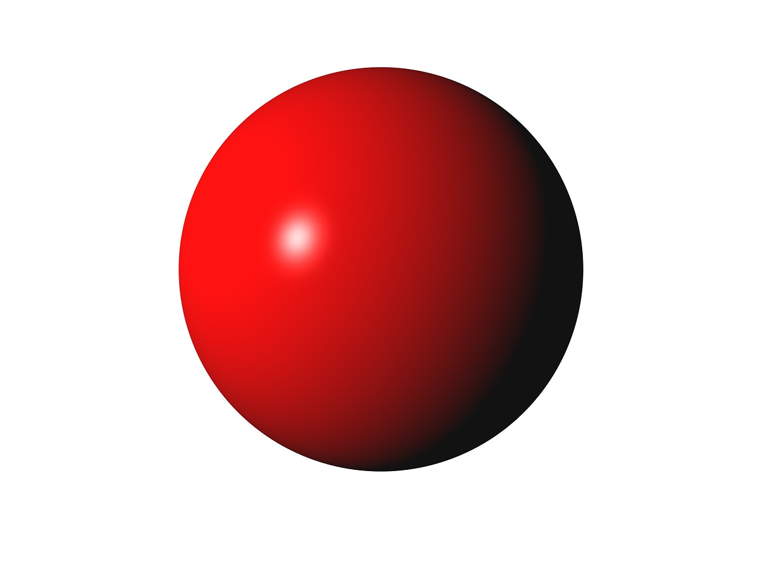
Why we need shading
Suppose we build a model of a sphere using many polygons. We color it with a single color as we have done so far. We get something like
But we want

Slide 3
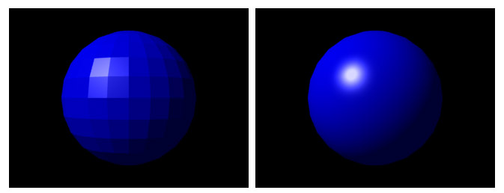
Shading
Shading refers to the process of determining the color for a pixel (or vertex…or polygon) during the rendering process
What is the difference between the two images?

Slide 4
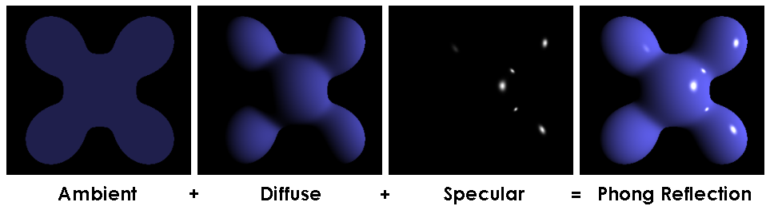
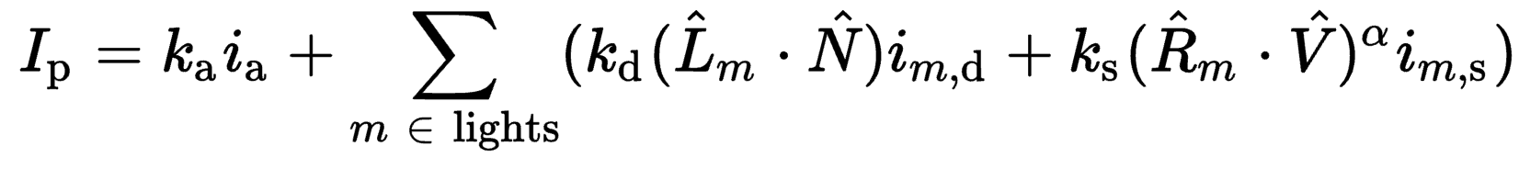
Phong Reflectance Model

Slide 5
Shading
Why does the image of a real sphere look like
Light-material interactions cause each point to have a different color or shade
Need to consider
Light sources
Material properties
Location of viewer
Surface orientation

Slide 6
Shading
Well…there’s a lot of symbols but the ideas and math are simple
We will create a simple mathematical model for shading
It will be function that takes in:
Light sources
Material properties
Location of viewer
Surface orientation
And returns a color….

Slide 7
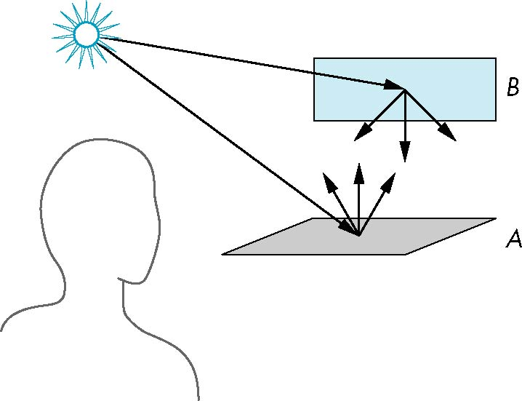
Scattering
Light strikes A
Some scattered
Some absorbed
Some of scattered light strikes B
Some scattered
Some absorbed
Some of this scattered light strikes A and so on

Slide 8
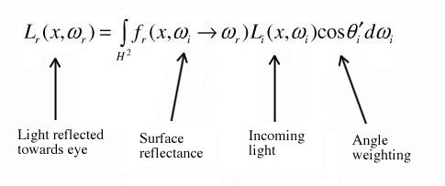
Rendering Equation
Scattering and absorption of light described by the rendering equation
Scattering and absorption are infinite phenomena
Cannot be solved in general analytically
Describes global lighting effects
CS 419 discusses solutions to the rendering equation
Ray-tracing, path tracing, etc.

Slide 9
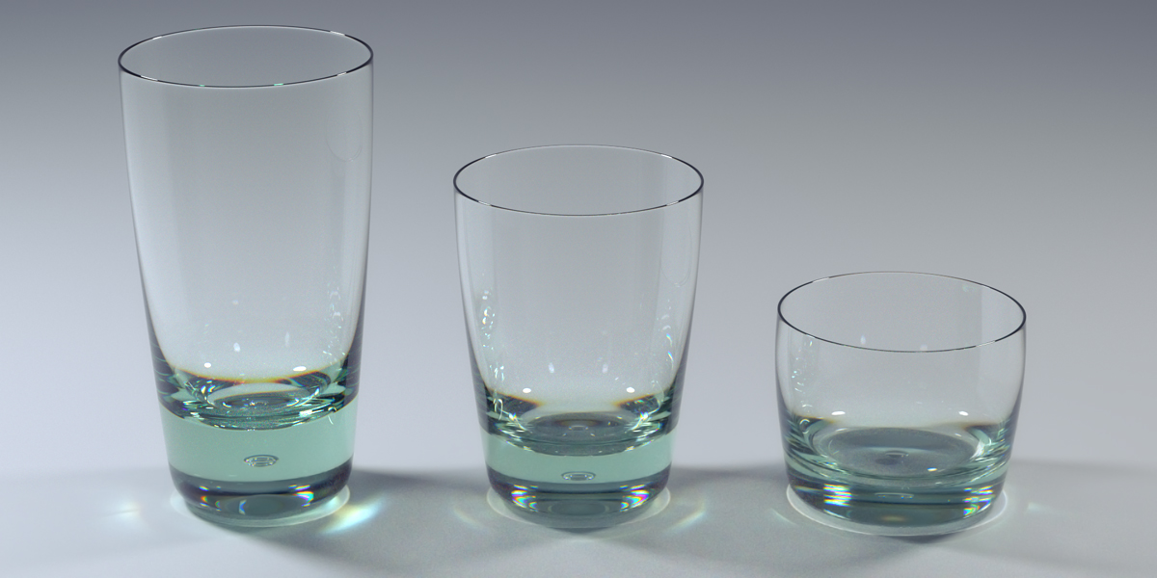
Global Effects

Slide 10
Local vs Global Illumination
Correct shading requires a global calculation involving all objects and light sources
Incompatible with pipeline model which shades each polygon independently
Why do we want to shade each polygon independently?
However, in computer graphics, we are happy if things “look right”
There exist many techniques for approximating global effects
Can anyone guess what you need to do to approximate global illumination in rasterization?

Slide 11
Light-Material Interaction
Light that strikes an object is
partially absorbed and
partially scattered (reflected)
The amount reflected determines
color of the object
brightness of the object
A surface appears red under white light because the red component of the light is reflected
How the reflected light is scattered depends on
the smoothness and orientation of the surface

Slide 12
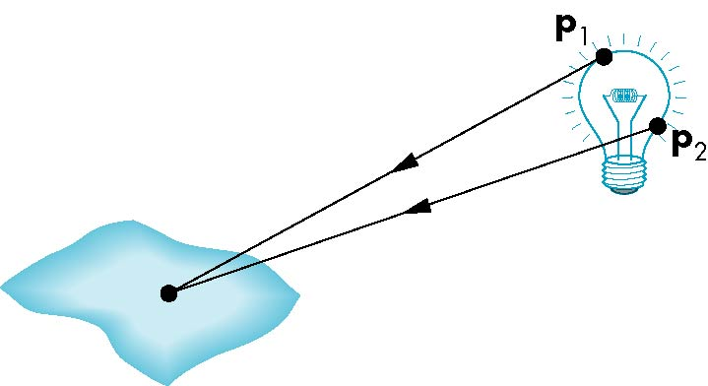
Light Sources
General light sources are complex to model
Would need to integrate light coming from all points on the source

Slide 13
Simple Light Source Models
Point source
Model with position and color
Directional source
Distant source = infinite distance away (parallel)
Ambient light
Same amount of light everywhere in scene
Can model contribution of many sources and reflecting surfaces

Slide 14
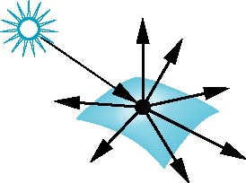
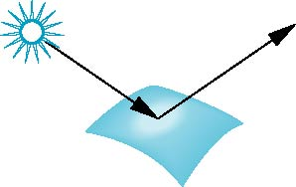
Surface Types
Consider light traveling along a specific ray
The smoother a surface, the more reflected light is concentrated in a single direction
Perfect mirror reflects perfectly in a single direction
A very rough surface scatters light in all directions
smooth surface
rough surface

Slide 15
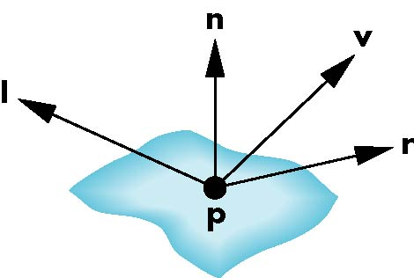
The Phong Reflection Model
A simple model that can be computed rapidly
Has three components
Diffuse
Specular
Ambient
Uses four vectors
To source
To viewer
Normal
Perfect reflector

Slide 16
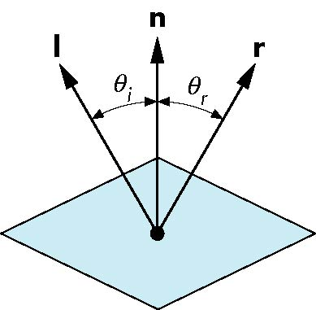

Modeling a Ideal Reflector – Specular Reflection
Incoming light ray is reflected in a single
Normal is determined by local orientation
Given the direction of incoming light…we can find r
l and n are unit vectors
Angle of incidence = angle of reflection
The three vectors will be coplanar
What is another name for an ideal reflector?
r is computed as
$$r=2(l⋅n)n−l$$

Slide 17
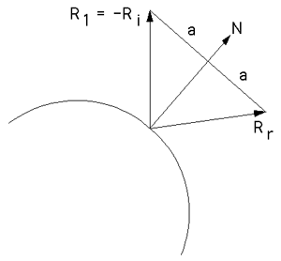
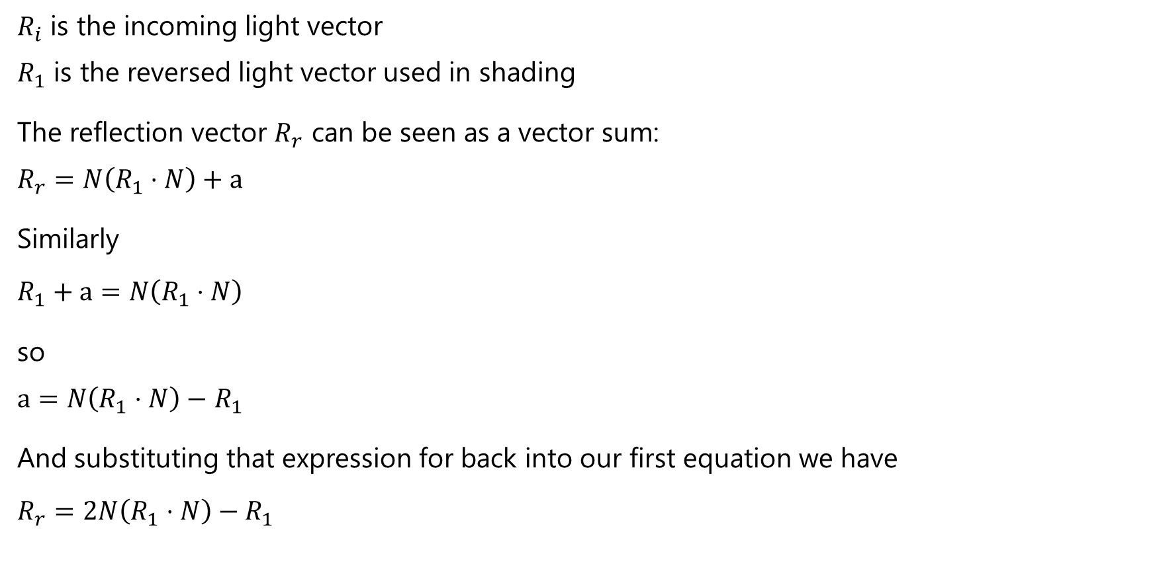
Deriving the Reflection Vector
$R_{i}$ is the incoming light vector $R_{1}$ is the reversed light vector used in shading
The reflection vector $R_{r}$ can be seen as a vector sum: $$R_{r}=N\left(R_{1}⋅N\right)+a$$
Similarly
$$R_{1}+a=N\left(R_{1}⋅N\right)$$
so $a=N\left(R_{1}⋅N\right)−$ $R_{1}$
And substituting that expression for back into our first equation we have
$$R_{r}=2N\left(R_{1}⋅N\right)−R_{1}$$

Slide 18
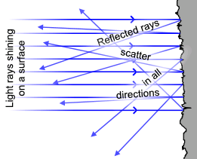
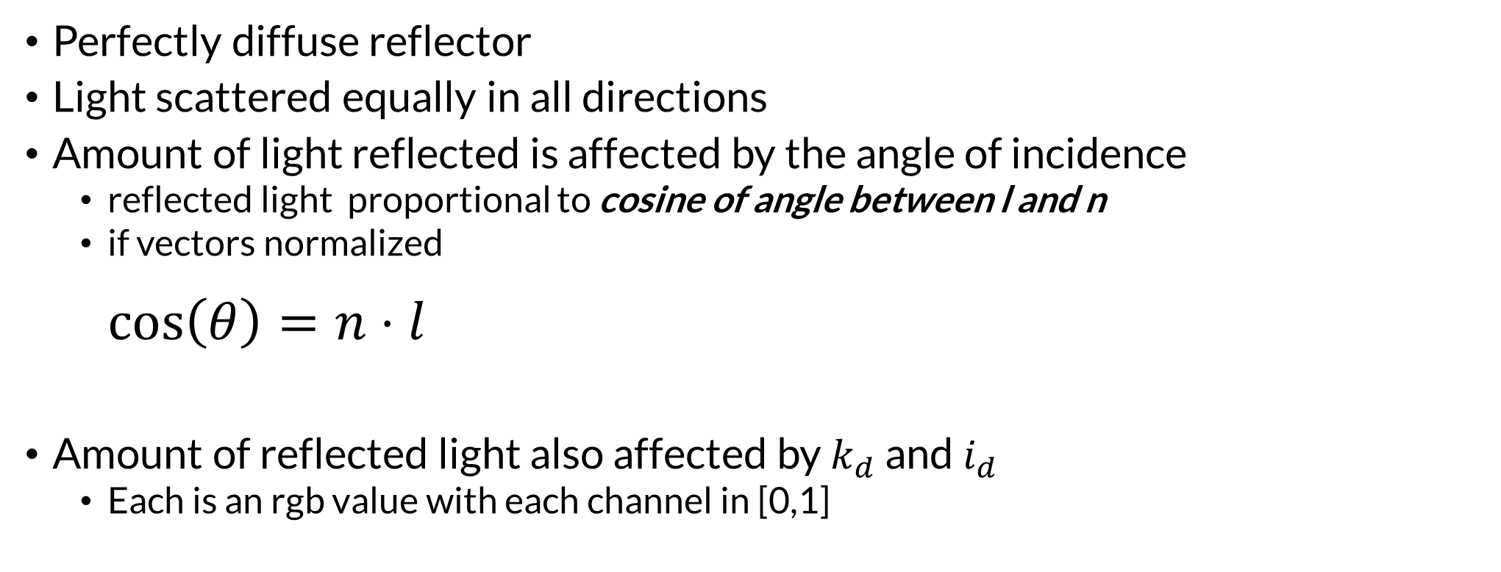
Modeling a Lambertian Surface – Diffuse Reflection
Perfectly diffuse reflector
Light scattered equally in all directions
Amount of light reflected is affected by the angle of incidence
reflected light proportional to cosine of angle between l and n
if vectors normalized $\cos\left(θ\right)=n⋅l$
Amount of reflected light also affected by $k_{d}$ and $i_{d}$
Each is an rgb value with each channel in [0,1]

Slide 19
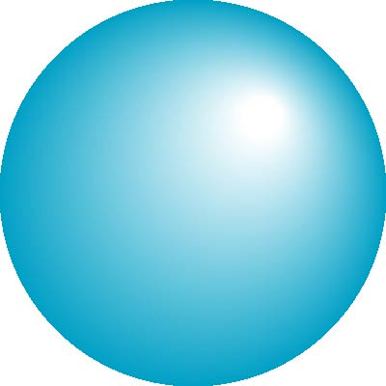
Specular and Diffuse Surfaces
Most surfaces are neither ideal diffusers nor perfectly specular (ideal reflectors)
Smooth surfaces show specular highlights
incoming light is reflected in directions concentrated close to the direction of a perfect reflection
specular
highlight

Slide 20
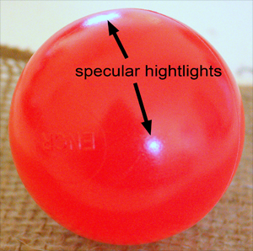
Specular Reflection
Perfect specular reflection
Light is reflected in the single direction r
…the mirror reflection direction
Glossy specular reflection
Scattering clustered around mirror reflection direction

Slide 21
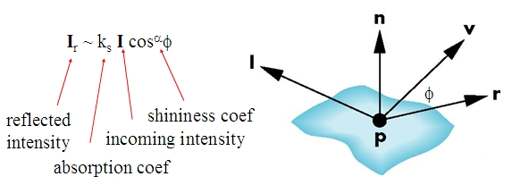
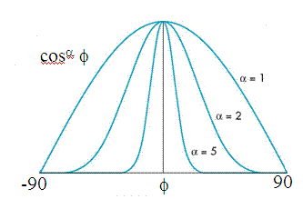
Specular Reflection
Reflectance determined by
Alignment of view vector with mirror reflection vector
Shininess coefficient
High coefficient means smoother look
Maybe 100 for metal
Maybe 10 for plastic

Slide 22
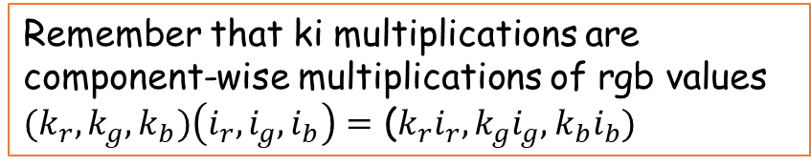
Ambient Light
Result of multiple interactions between light sources and surfaces
Amount and color depend on the color of the light(s) and the material properties
Add k_{a} I_{a} to diffuse and specular terms
Remember that ki multiplications are component-wise multiplications of rgb values
${(k}_{r},k_{g},k_{b})\left(i_{r},i_{g},i_{b}\right)=$ (${k_{r}i}_{r},k_{g}i_{g},k_{b}i_{b})$
reflection
intensity of ambient light

Slide 23
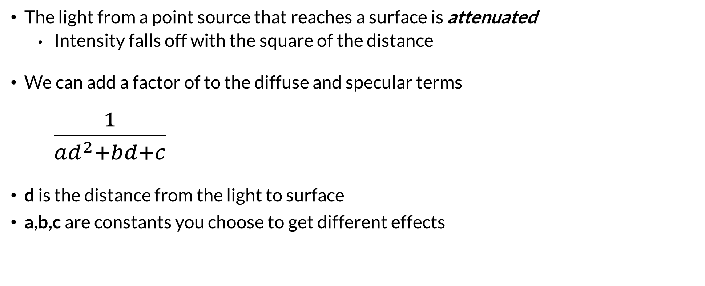
Distance Terms
The light from a point source that reaches a surface is attenuated
Intensity falls off with the square of the distance
We can add a factor of to the diffuse and specular terms $\frac{1}{{ad}^{2}+bd+c}$
d is the distance from the light to surface
a,b,c are constants you choose to get different effects

Slide 24
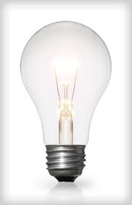
Light Sources
In the Phong Model, we add the results from each light source
Each light source has separate terms for
diffuse
specular
ambient terms
This form does not have a physical justification
Separate red, green and blue components
Hence, 9 coefficients for each point source
I_{dr}, I_{dg}, I_{db}, I_{sr}, I_{sg}, I_{sb}, I_{ar}, I_{ag}, I_{ab}

Slide 25
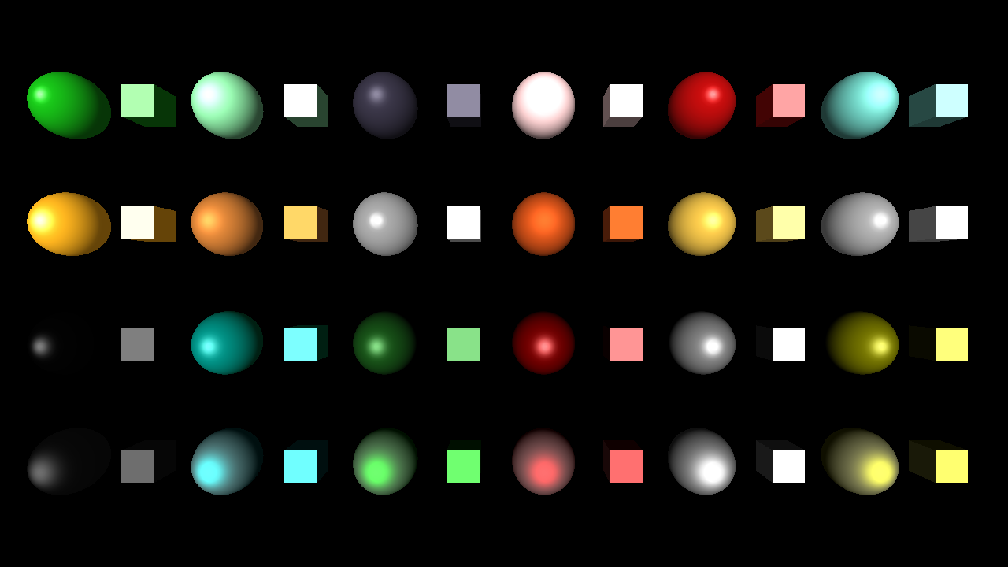

Material Properties
Material properties match light source properties
Nine reflection coefficients
k_{dr}, k_{dg}, k_{db}, k_{sr}, k_{sg}, k_{sb}, k_{ar}, k_{ag}, k_{ab}
These vary from 0 to 1
Materials also have shininess coefficient $α$

Slide 26
Phong Reflectance Model
Summing over all the light sources, the Phong model can be written as

Slide 27
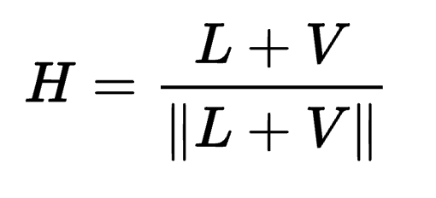
Blinn-Phong Reflectance Model
Jim Blinn suggested an approximating changing specular term
Replace (V · R )ª by (N · H )^{b} where
“Halfway vector”
More efficient in terms of the operations used
Closer to physically correct lighting
Pick exponent b to match what you want
Using higher b>a will make output similar to Phong with a

Slide 28

The Halfway Vector
H is normalized vector halfway between L and V
$$r=2(l⋅n)n−l$$

Slide 29
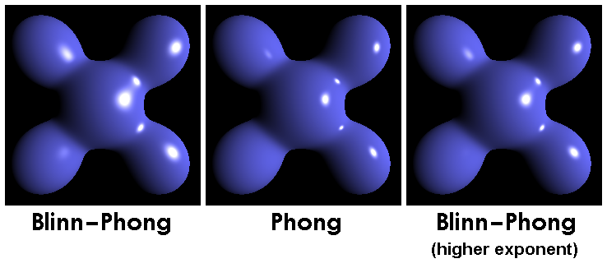
Phong versus Blinn-Phong

Slide 30
Moving Light Sources
Light sources are geometric objects
Positions and directions can be affected a model-view matrix
Should you apply the view transformation to a light?
Depending on what we want to happen in a scene we can
Move the light source(s) with the object(s)
Fix the object(s) and move the light source(s)
Fix the light source(s) and move the object(s)
Move the light source(s) and object(s) independently

Slide 31
Specifying a Point Light Source
For each light source define an RGBA or RGB color for
diffuse component
specular component
You could specify a per-light ambient too…
…or just have one ambient light source…..
Specify the position
var diffuse0 = vec4.fromValues(1.0, 0.0, 0.0, 1.0);
var specular0 = vec4.fromValues (1.0, 0.0, 0.0, 1.0);
var light0_pos = vec4.fromValues (1.0, 2.0, 3,0, 1.0);

Slide 32
Light Properties
var lightPosition = vec4.fromValues (1.0, 1.0, 1.0, 0.0 );
var lightDiffuse = vec4.fromValues ( 1.0, 1.0, 1.0, 1.0 );
var lightSpecular = vec4.fromValues ( 1.0, 1.0, 1.0, 1.0 );
What does the w=0 tell us about what kind of light this is?

Slide 33
Material Properties
Material properties
should match the terms in the light model
Reflectivities
Last component gives opacity
var materialAmbient = vec4.fromValues( 1.0, 0.0, 1.0, 1.0 );
var materialDiffuse = vec4.fromValues( 1.0, 0.8, 0.0, 1.0);
var materialSpecular = vec4.fromValues( 1.0, 0.8, 0.0, 1.0 );
var materialShininess = 100.0;

Slide 34
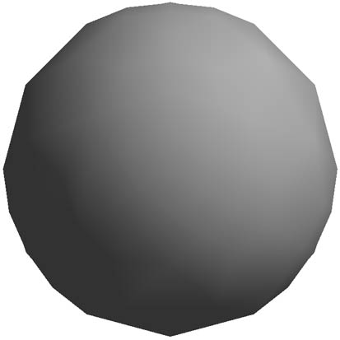
Smooth Shading on a Sphere Mesh
I know…silhouette edge is bumpy for a sphere…
How do you make it less bumpy?
Why does the middle look smooth?
We set a new normal at each vertex
Per-vertex normal easy for a sphere model
If centered at origin n = p
What is the normal at the vertex (1,0,0)?

Slide 35
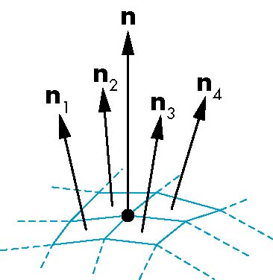
Mesh Shading
The previous example is not general
We knew the normal at each vertex analytically
For polygonal meshes, Henri Gouraud proposed we
use the average of the normals around a vertex
n = (n₁+n₂+n₃+n₄)/ |n₁+n₂+n₃+n₄|

Slide 36
Computing a Normal for a Triangle
n
plane n ·(p - p₀ ) = 0
p₂
n = (p₁ - p₀ ) × (p₂ - p₀ )
p
p₁
normalize n ← n/ |n|
p₀
You can use the glMatrix library to compute normals for vertices
36
36

Slide 37
Computing per-Vertex Normals
To compute per-vertex normal on a mesh with M vertices
Initialize an array NArray containing M normals
Each normal starts as [0,0,0]
Iterate over all triangles T=[v1,v2,v3] with vi in CCW order
Compute normal N for T using N = (v2-v1)X(v3-v1)
NArray[v1]+=(Narray[v1]+N)
NArray[v2]+=(Narray[v2]+N)
NArray[v3]+=(Narray[v3]+N)
Normalize each normal in Narray to unit length

Slide 38
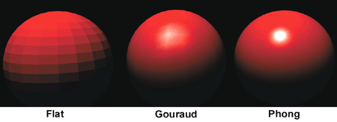
Gouraud and Phong Shading
Gouraud Shading
Find average normal at each vertex
Apply Blinn-Phong model at each vertex
Interpolate vertex shades across each polygon
Phong shading
Find average normal at each vertex
Interpolate vertex normals across edges
Interpolate edge normals across polygon
Apply Blinn-Phong model at each fragment

Slide 39
Shading in the Vertex Shader
attribute vec3 aVertexNormal;
attribute vec3 aVertexPosition;
uniform mat4 uMVMatrix;
uniform mat4 uPMatrix;
uniform mat3 uNMatrix;
uniform vec3 uLightPosition;
uniform vec3 uAmbientLightColor;
uniform vec3 uDiffuseLightColor;
uniform vec3 uSpecularLightColor;
uniform vec3 uKAmbient;
uniform vec3 uKDiffuse;
uniform vec3 uKSpecular;
uniform float uShininess;
varying vec4 vColor;
This is the Phong reflection model with Gouruad shading
This is just one example…different options in implementation
e.g. you could have material properties as attributes
Use uniforms for parameters constant over all vertices

Slide 40
Shading in the Vertex Shader
// Get the vertex position in eye coordinates
vec4 vertexPositionEye4 = uMVMatrix * vec4(aVertexPosition, 1.0);
vec3 vertexPositionEye3 = vertexPositionEye4.xyz / vertexPositionEye4.w;
// Calculate the vector (l) to the light source
vec3 vectorToLightSource = normalize(uLightPosition - vertexPositionEye3);
// Transform the normal (n) to eye coordinates
vec3 normalEye = normalize(uNMatrix * aVertexNormal);
// Calculate n dot l for diffuse lighting
float diffuseLightWeightning = max(dot(normalEye,
vectorToLightSource), 0.0);
// Calculate the reflection vector (r) that is needed for specular light
vec3 reflectionVector = normalize(reflect(-vectorToLightSource,
normalEye));
// The camera in eye coordinates is located in the origin and is pointing
// along the negative z-axis. Calculate viewVector (v)
// in eye coordinates as:
// (0.0, 0.0, 0.0) - vertexPositionEye3
vec3 viewVectorEye = -normalize(vertexPositionEye3);
float rdotv = max(dot(reflectionVector, viewVectorEye), 0.0);
float specularLightWeightning = pow(rdotv, uShininess);
Why is vectorToLightSource negated for reflection?

Slide 41
Shading in the Vertex Shader
// Sum up all three reflection components and send to the fragment shader
vColor = vec4(((uAmbientLightColor*uKAmbient)
+ (uDiffuseLightColor*uKDiffuse) * diffuseLightWeightning
+ ((uSpecularLightColor*uKSpecular) * specularLightWeightning)),1.0);
gl_Position = uPMatrix*uMVMatrix*vec4(aVertexPosition, 1.0);
Fragment shader is simple
precision mediump float;
varying vec4 vColor;
void main(void) {
gl_FragColor = vColor;
}

Slide 42
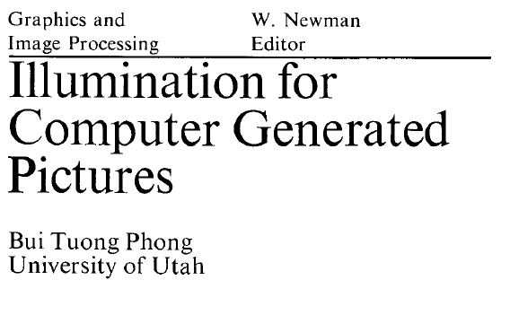
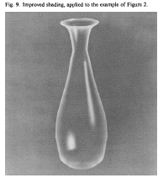
Bui Tuong Phong
December 14, 1942 – July 1975
Born in Hanoi
Earned his PhD in 2 years at the University of Utah (1973)
Worked with Professor Ivan Sutherland
Dissertation work was the Phong reflectance model
Also produced model and realistic image of a VW bug

Slide 43
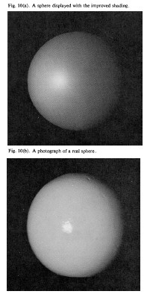
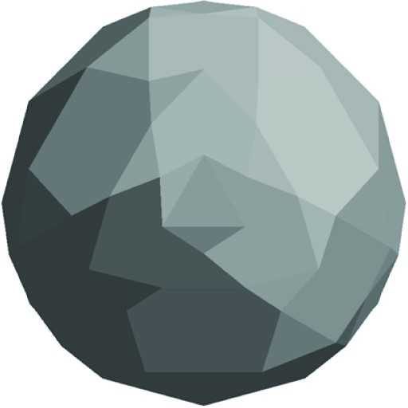
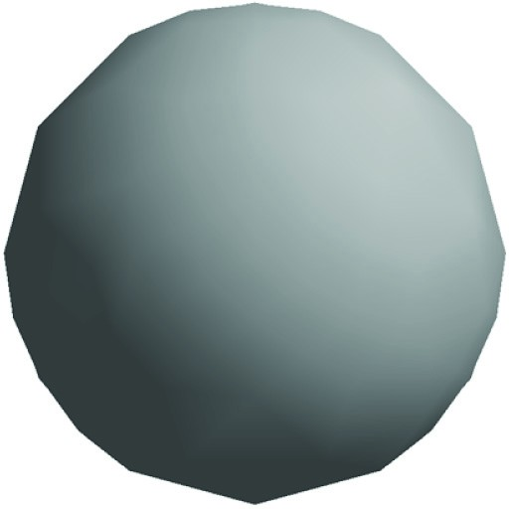
Sphere with Phong Shading
From original paper on the Phong Model
Using true normals, different normal at each vertex
Flat Shading: Each triangle drawn using same normal at each vertex

